Slide 1
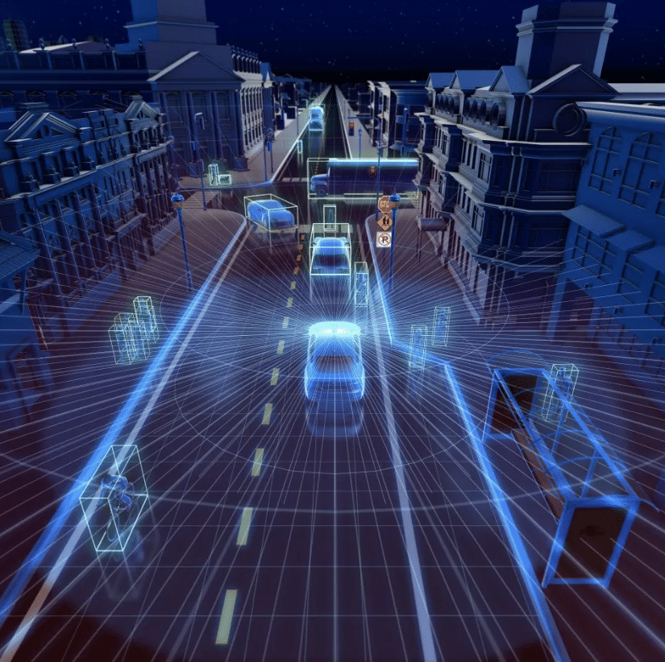
Object Detection & Tracking in 4D RADAR for Enhanced Autonomous Vehicle Perception
Presented by Nick Timaskovs

Slide 2
Aims & Objectives
The aim of this thesis is to develop and or implement an Object Detection and Tracking architecture for 4D RADAR, for enhanced Autonomous vehicle perception.
Create a UI for visualizing the detections during model evaluation.
Preform experiments on various model configurations.

Slide 3
Aims & Objectives
To learn how to use and understand the 4D RADAR point cloud data structure.
Break the barrier to entry, with a plug and play solution improving accessibility.
Contribute to RaTrack with improvements.

Slide 4
Challenges in Autonomous Vehicles
Sensor Fusion and Perception
Clutter, Interference and noise
Detection of Vulnerable Road Users
Safety and Reliability
Data Collection and Processing
Cost and Implementation

Slide 5
Motivation:
Motivations
Personal Experience - wanting to improve road safety
Specialize in computer vision & ML to work in this field
Improve current solutions to help drive innovation in Advanced Driver Assistance Systems (ADAS)
Interest in the automotive industry.

Slide 6
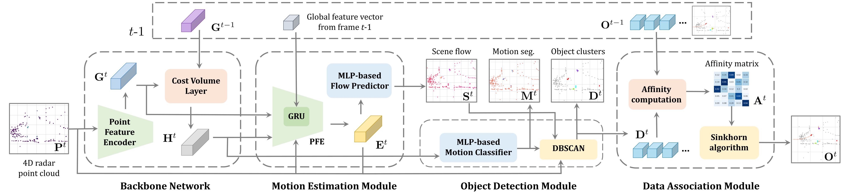
Architecture of RaTrack

Slide 7
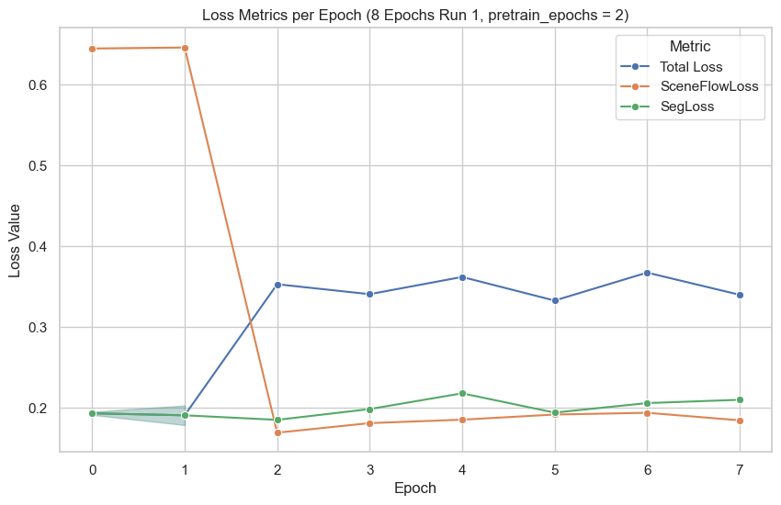
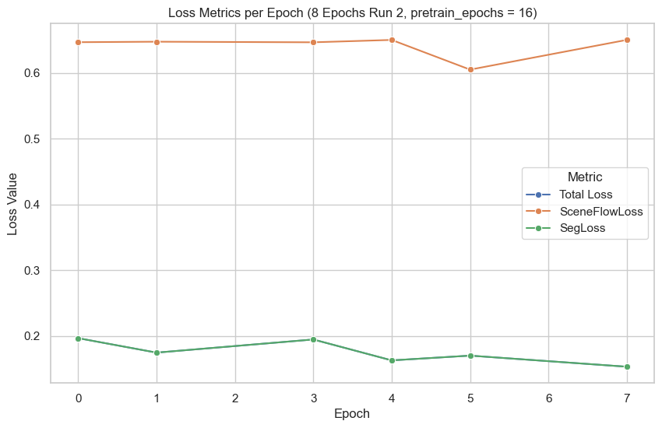
Training Results

Slide 8
Evaluation Results on 8 epochs
Segmentation
Scene Flow
Metric | Run 1 | Run 2 | Better Run
Accuracy | 0.915624 | 0.929237 | Run 2
MIoU | 0.588501 | 0.610672 | Run 2
Sensitivity | 0.869579 | 0.884062 | Run 2
Metric | Run 1 | Run 2 | Better Run
RNE | 0.126901 | 0.274913 | Run 1
SAS | 0.996817 | 0.988114 | Run 1
EPE | 0.299801 | 0.648234 | Run 1
Run 1: pretrain_epochs = 2
Run 2: pretrain_epochs = 16

Slide 9
Comparing 8 vs 10 epochs
Segmentation
Scene Flow
Metric | 10 Epoch | 8 Epoch | Better Model
Accuracy | 0.902215 | 0.929237 | Epoch 8
MIoU | 0.569491 | 0.610672 | Epoch 8
Sensitivity | 0.849747 | 0.884062 | Epoch 8
Metric | 10 Epoch | 8 Epoch | Better Model
RNE | 0.115484 | 0.274913 | Epoch 10
SAS | 0.997415 | 0.988114 | Epoch 10
EPE | 0.272903 | 0.648234 | Epoch 10
10 Epochs: pretrain_epochs = 2
8 Epochs: pretrain_epochs = 16

Slide 10
Challenges Faced
Dataset Acquisition
Original implementation was not feasible
Lack of code standards / bad practices
Computational Complexity (1hr per epoch)
Solution Complexity
Steep Learning Curve

Slide 11
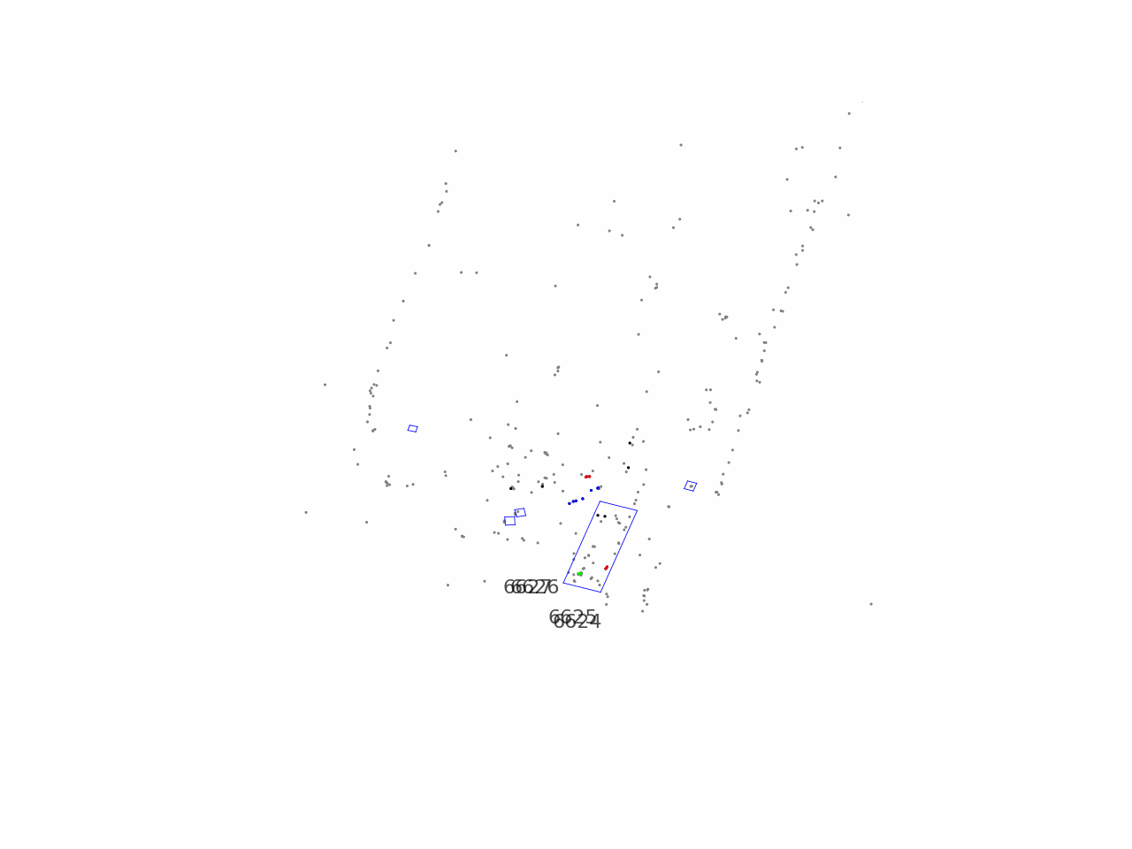
Questions?

